Slide 1


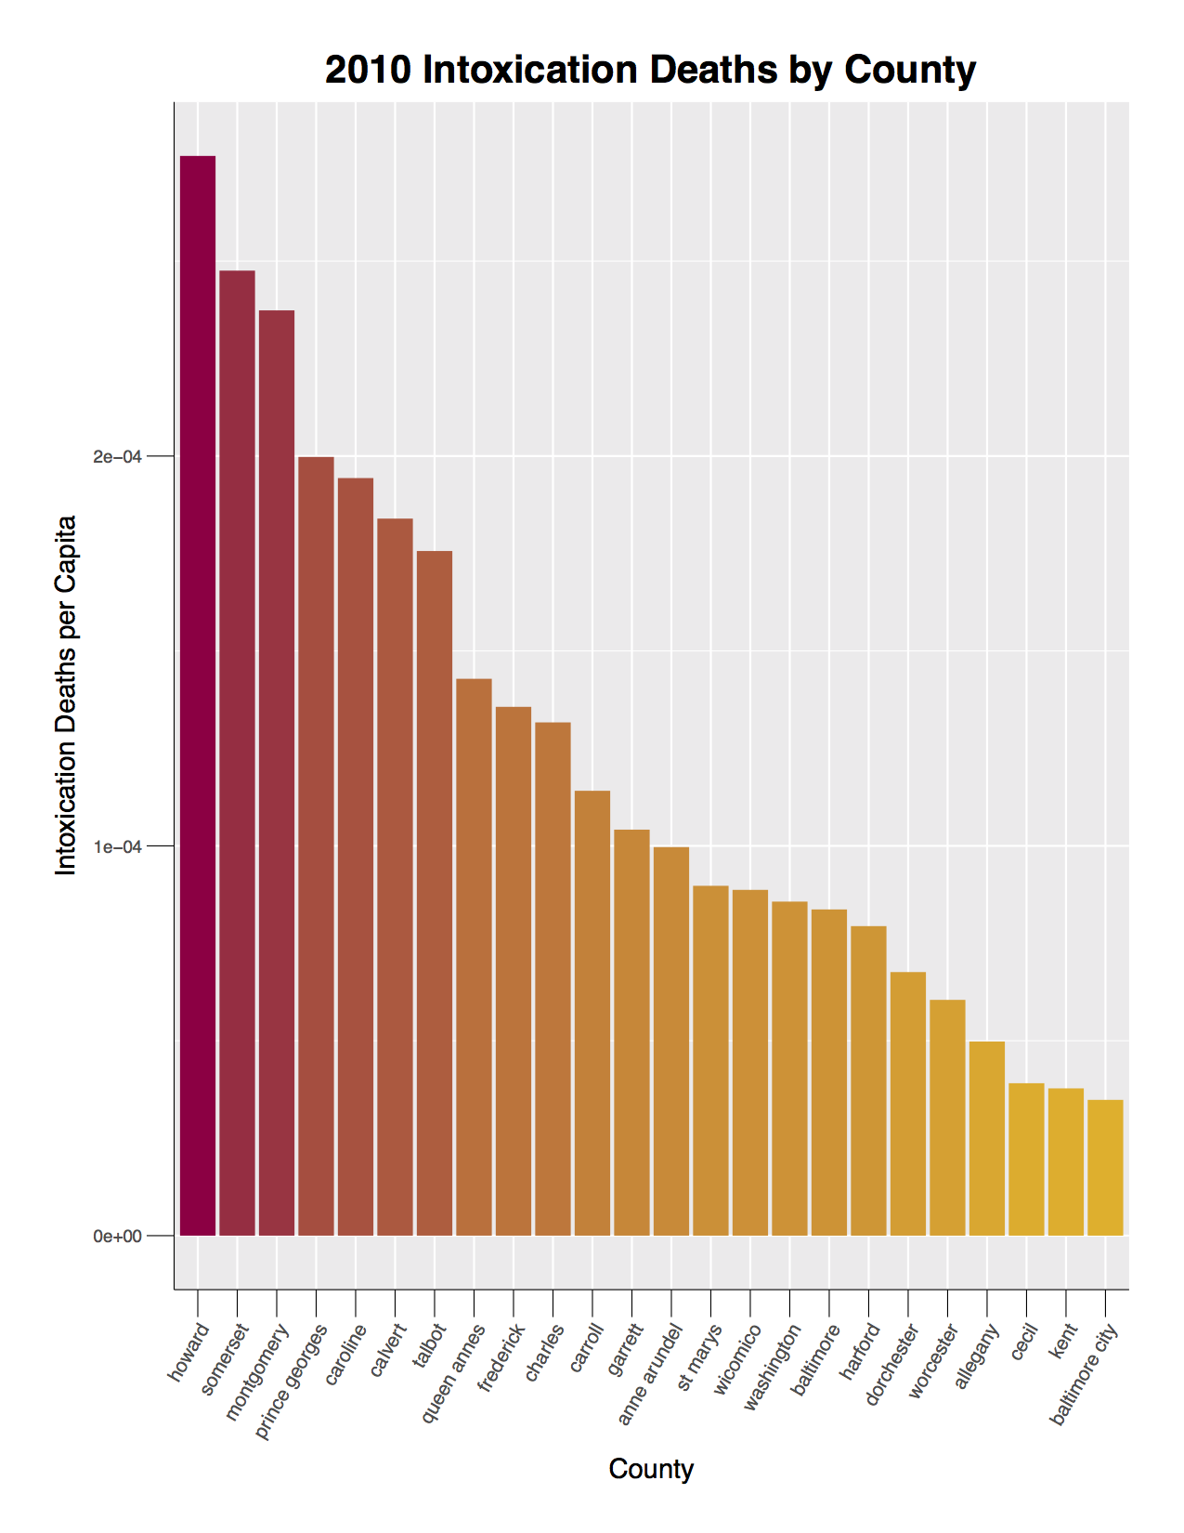
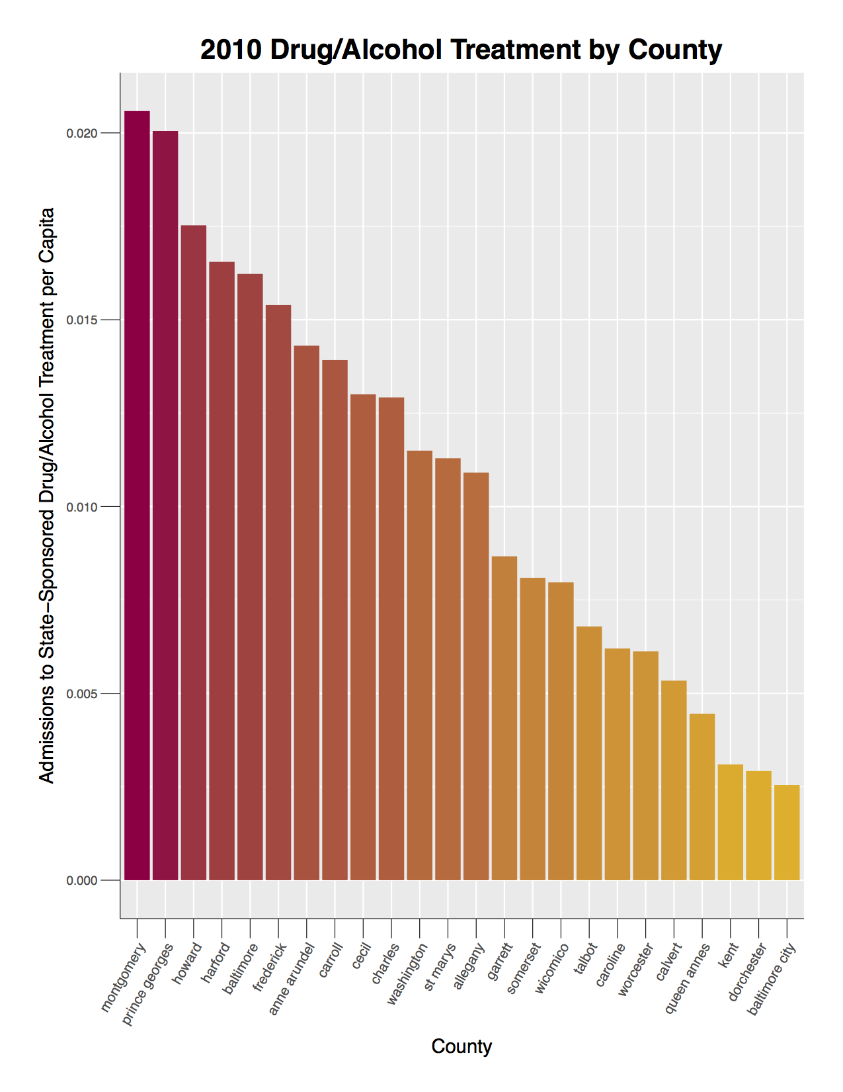
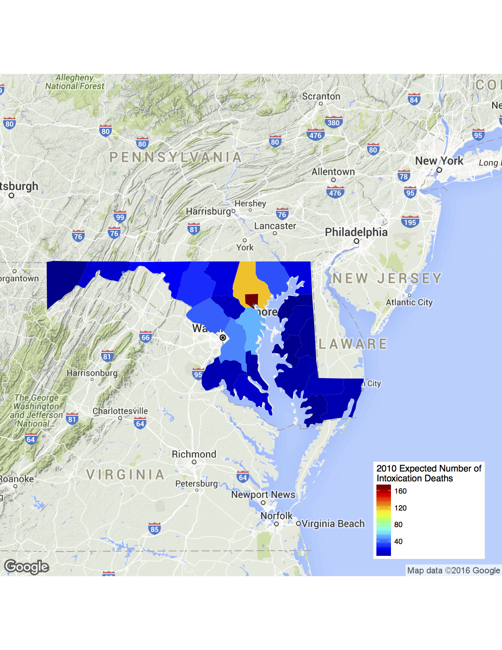
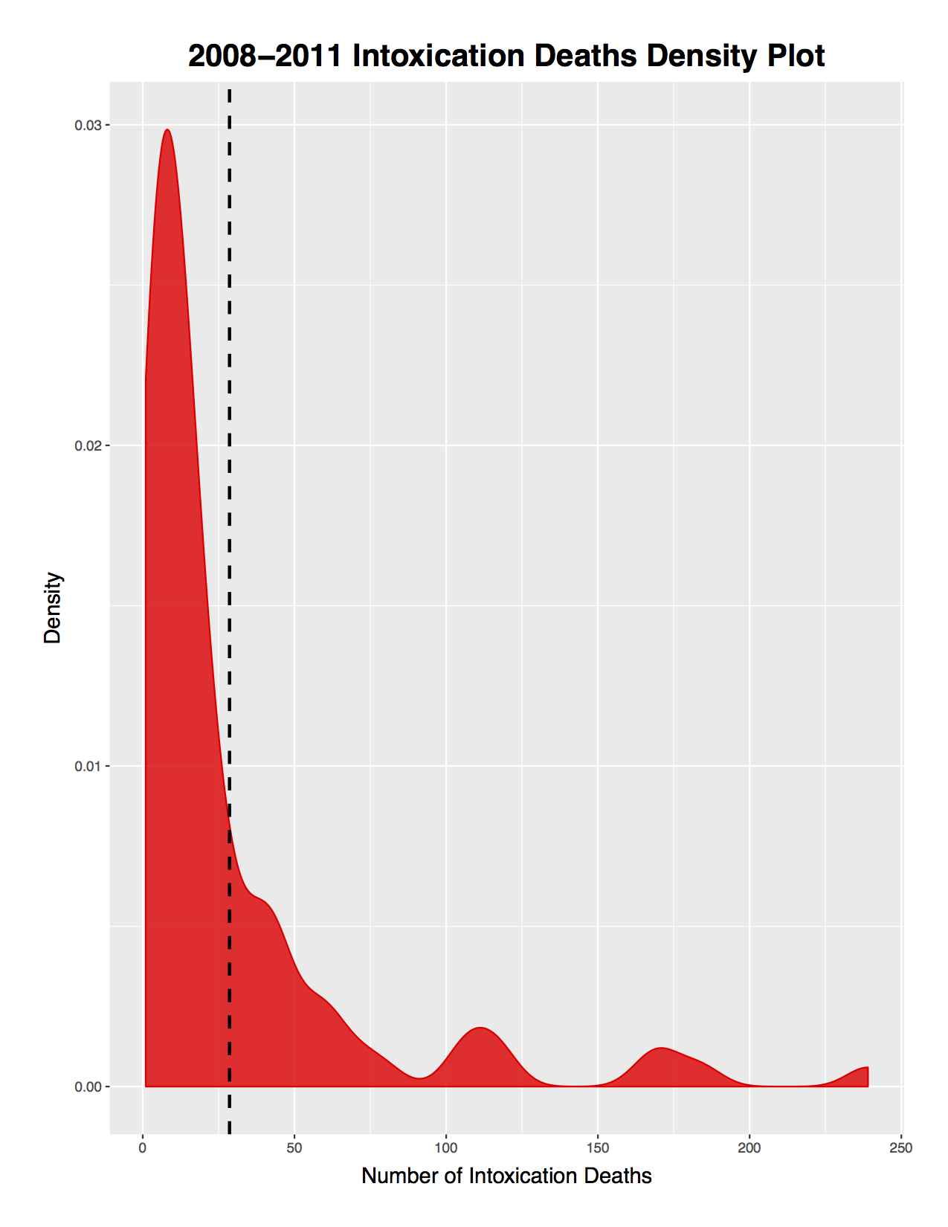
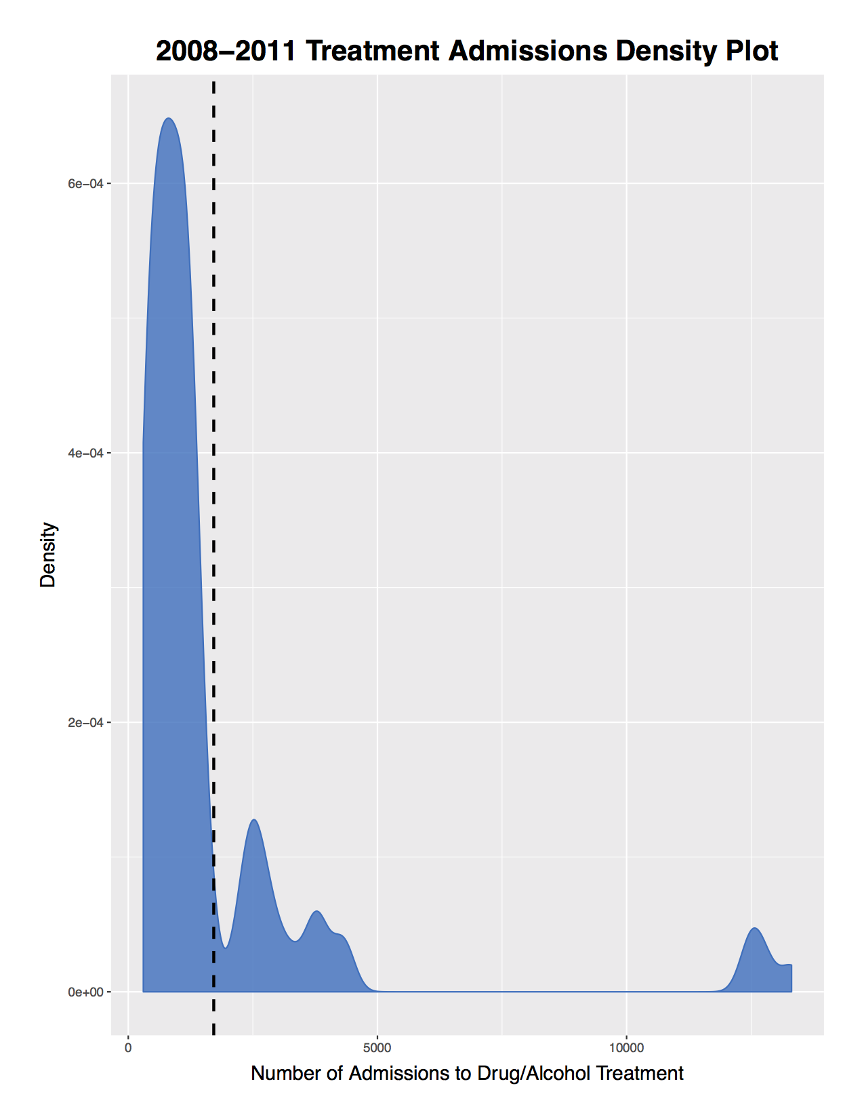
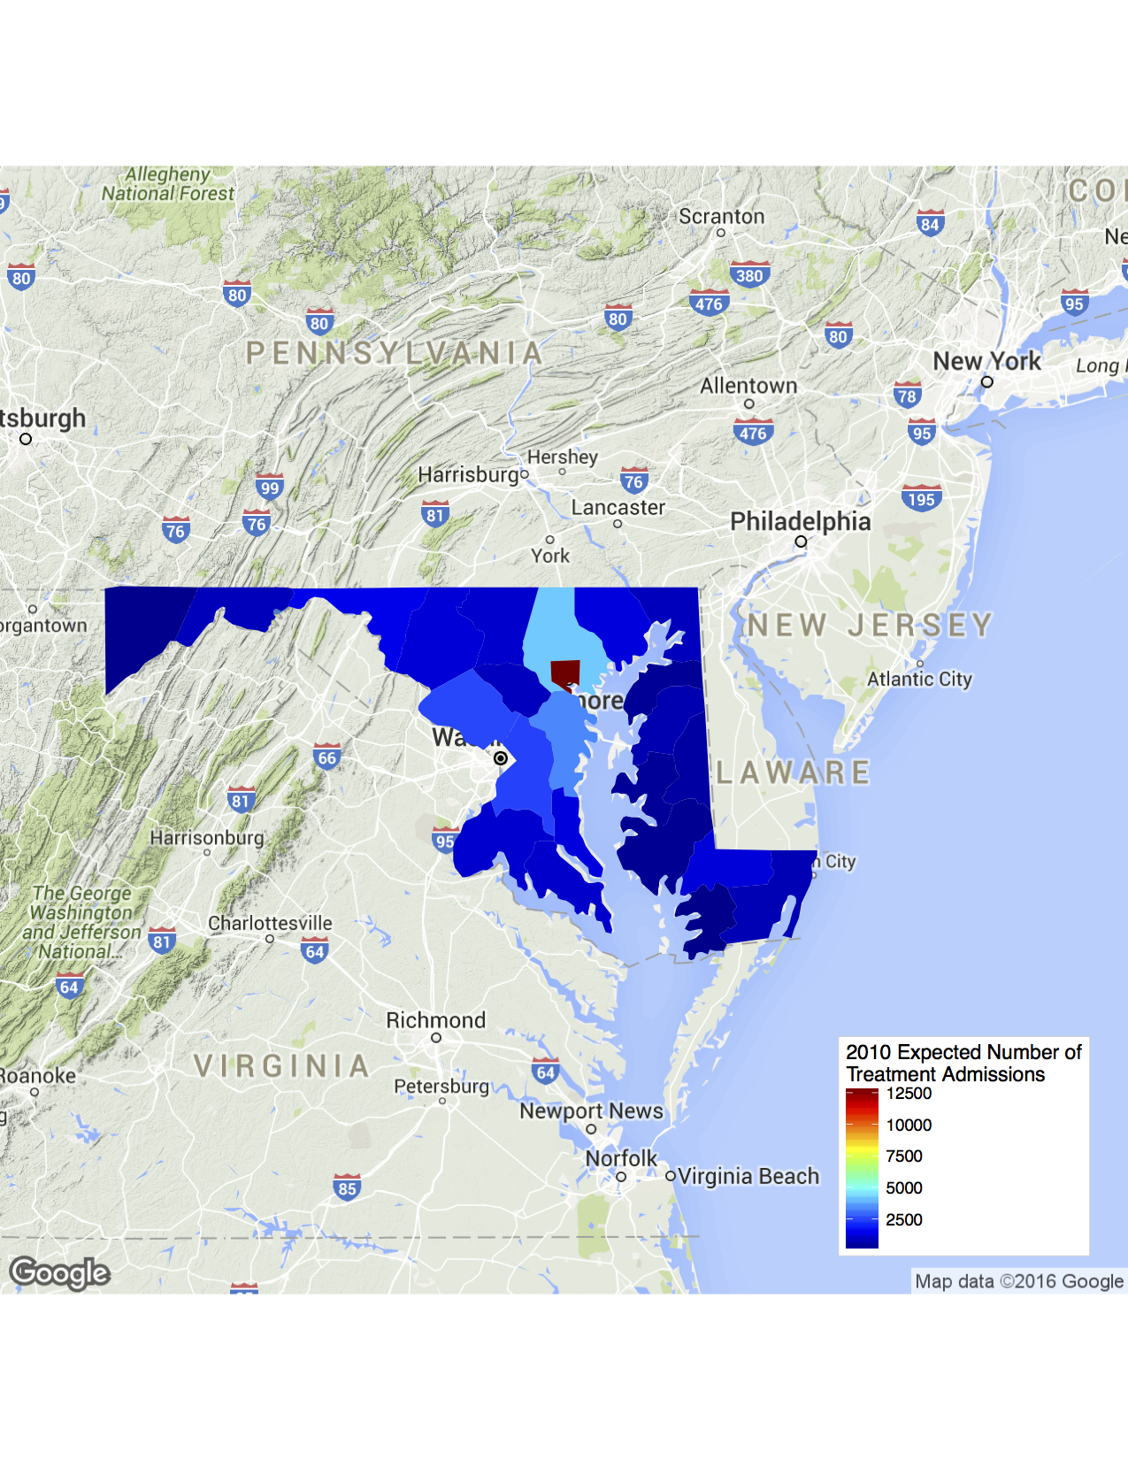




Estimating the Distribution of Intoxication Deaths and Treatment Admissions in Maryland Jon Matthew | Melanie Kohout | Dr. Earvin Balderama Loyola University Chicago, FYRE Program
Objectives
Diagrams
Conclusions
Estimate the number of Drug/Alcohol-related intoxication deaths in counties of Maryland
Estimate the number of admissions to state-supported drug/alcohol treatment in counties of Maryland
Bar plots of true values for number of drug/alcohol-related intoxication deaths per capita and number of admissions to state-supported drug/alcohol treatment per capita in 2010
Maps of expected values for number of drug/alcohol-related intoxication deaths and number of admissions to state-supported drug/alcohol treatment in 2010
Expected value maps based on generalized linear models
Significant x-variables for intoxication death model
Significant x-variables for treatment admissions model
X-Variable | Estimated Coefficient
Median Age | 1.874e-01
Median Household Income | 3.984e-05
Annual Number of Public High School Graduates | -3.299e-04
Total Average Annual Employment | 7.857e-06
Data
Y-variables: drug/Alcohol-related intoxication deaths and admissions to state-supported treatment
X-variables: property crimes, violent crimes, population, demographics, quality of life, geography, employment, transportation, education, and government expenditures
All observations organized by county
Bar Plots
of true values
X-Variable | Estimated Coefficient
Annual Number of Public High School Graduates | -6.780e-04
Percent Bachelor’s Degree Attainment | -4.181e-00
Total Average Annual Employment | 1.406e-05
Methods
Height of bar plots rendered from intoxication deaths and drug/alcohol treatment divided by population to obtain per capita values and minimize confounding from population
Data from one year selected for consistency; 2010 has most available data
Data on intoxication deaths and drug/alcohol treatment approximately follow the Poisson distribution but with some overdispersion
Generalized linear model receives vector of possible explanatory variables
Stepwise function compares y-variable to multiple x-variables to write equation that attempts to estimate true y-variable values with the least error
2010 population data used as offset variable to minimize confounding from population
Extra code compensates for overdispersion of distribution of y-variables to provide more clarity on which x-variables are significant
Intoxication Deaths
Future Considerations
map of expected values
Model may be successful at predicting future numbers of intoxication deaths and treatment admissions for counties in Maryland with only the above x-variables
Could include other x-variables in the model
Model is limited by inability of Poisson distribution to account for the overdispersion of the y-variables
Negative binomial distribution may be a better fit for the data
Could apply the model to x-variable data from other states
Could apply similar model to predict other y-variables such as crimes or hospital needs
Treatment Admissions
map of expected values
Acknowledgments
Software used: (www.r-project.org)
Plots made with: ggplot2 package in
Maps made with: ggmap package in
Data acquired from
Thanks to Dr. Earvin Balderama, Dr. Mark Albert, and the following:

